Slide 1
EDA & ML ON IRIS DATASET USING PYTHON
Presented By: Saloni Swagata
(VT20204420)

Slide 2
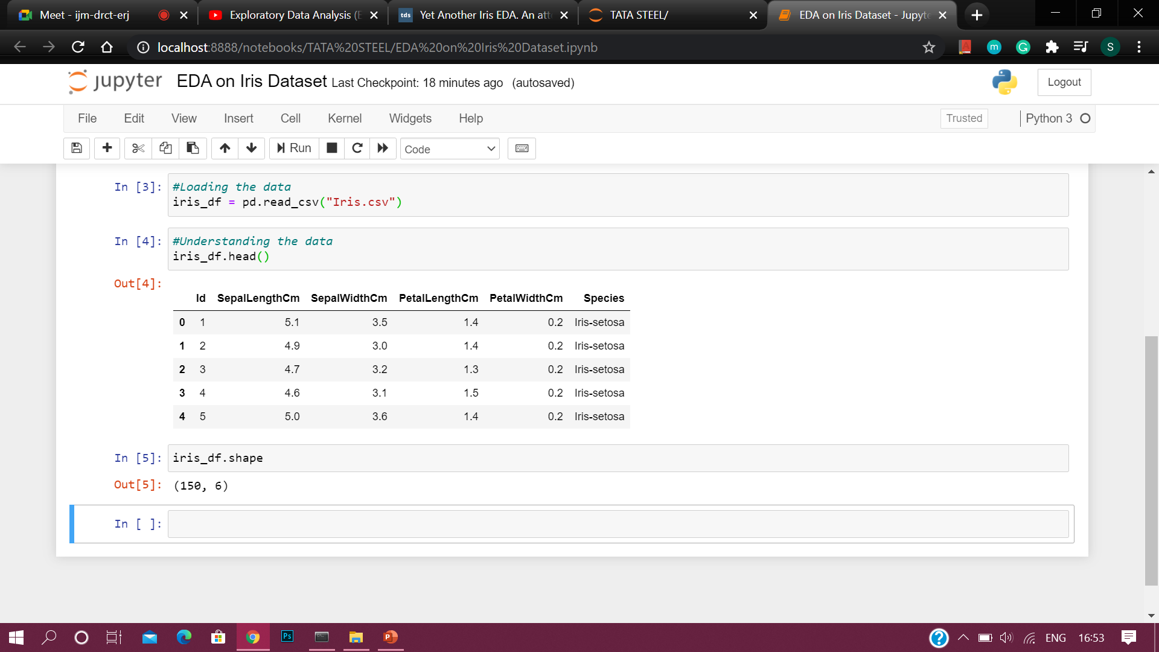
The features present in the dataset are-
Sepal Length
Sepal Width
Petal Length
Petal Width
We also observe that our dataset has 150 rows and 6 columns

Slide 3
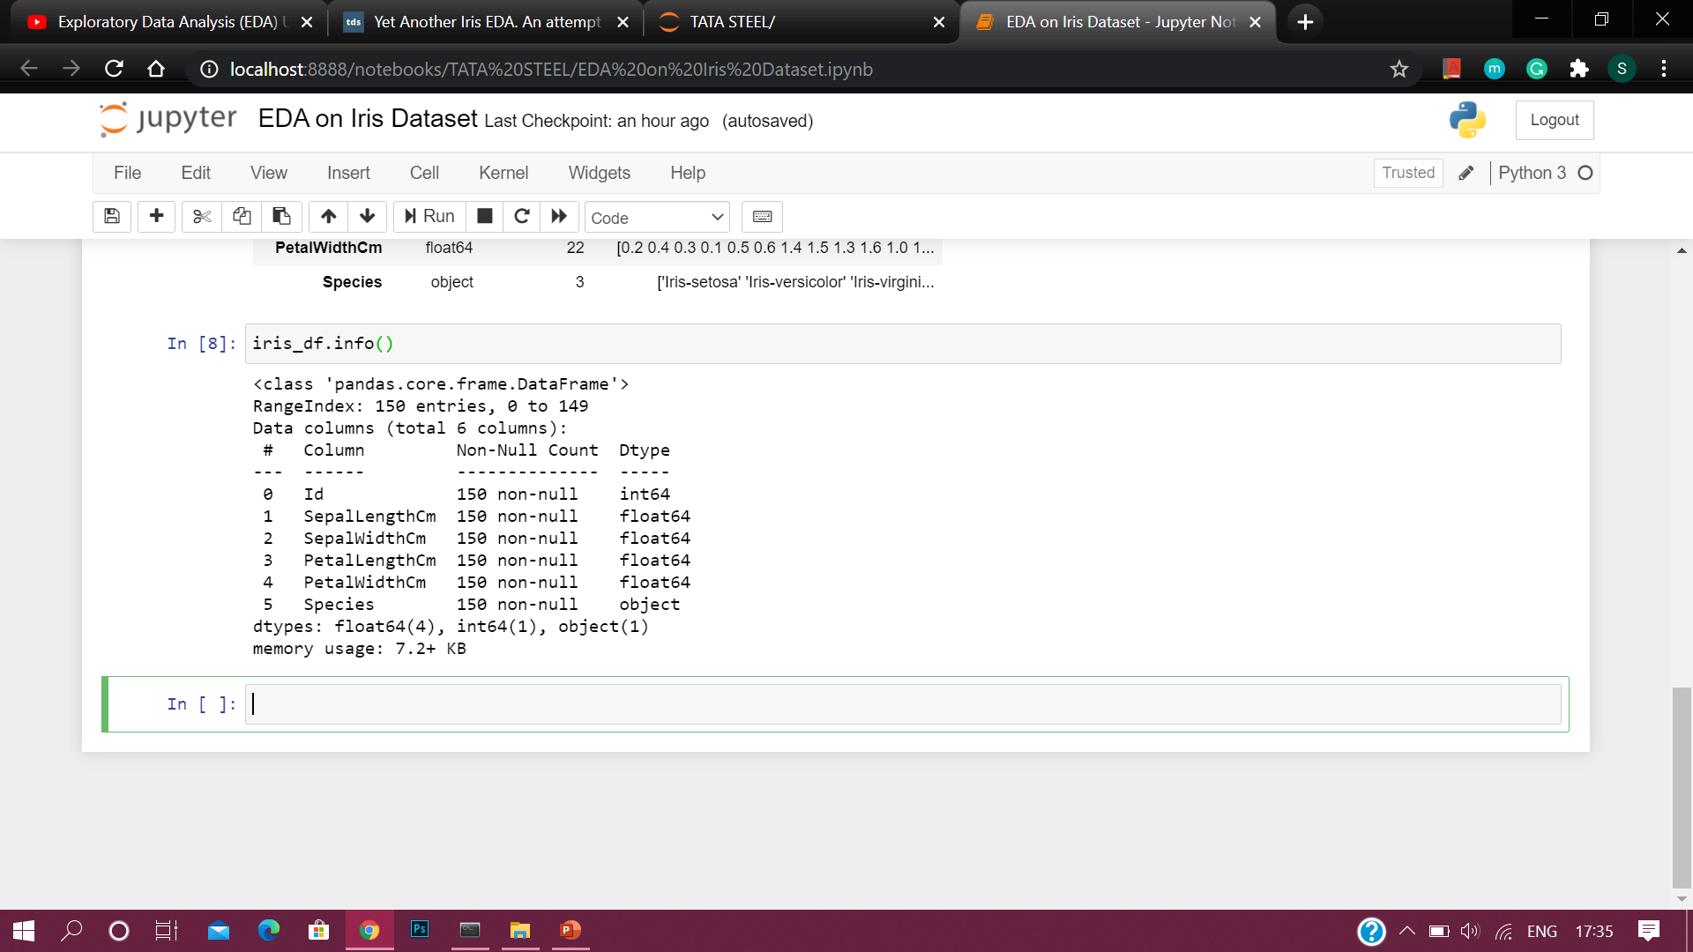
We see all the columns of our data set are free from null values and five of them are numeric while one is a categorical column

Slide 4
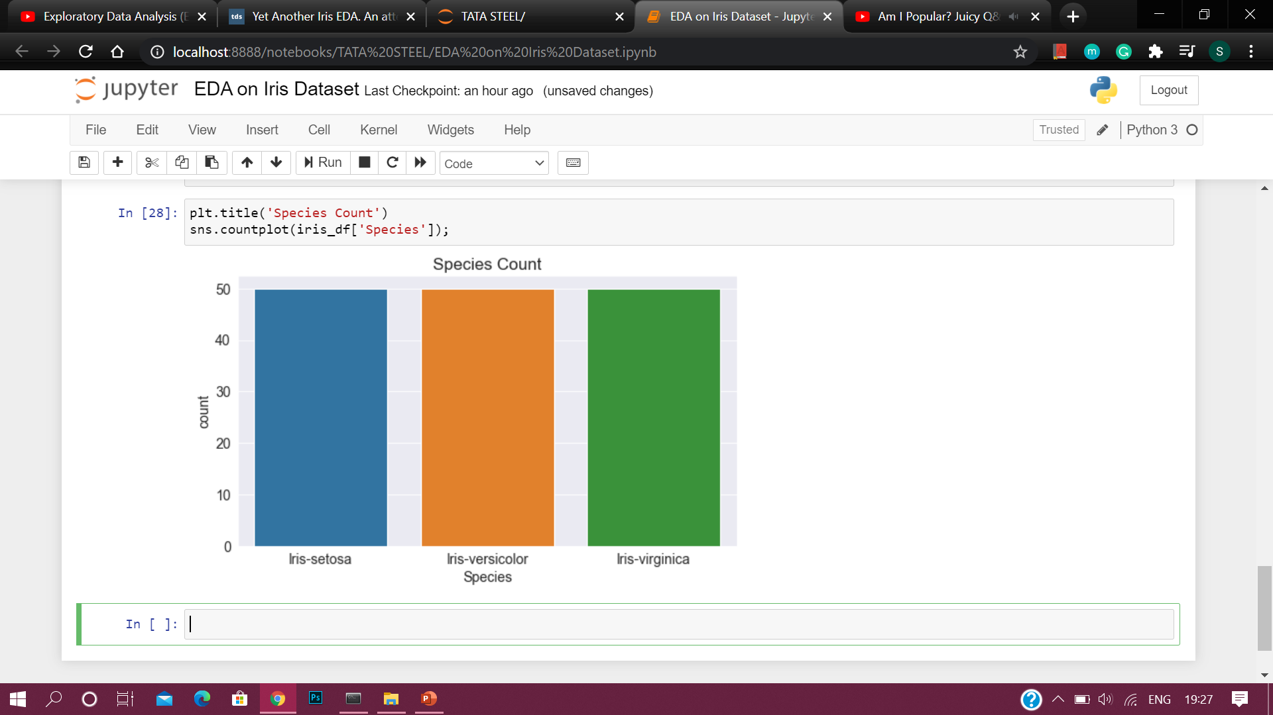
This graph tells us that the dataset is balanced with equal records for all the three species.

Slide 5
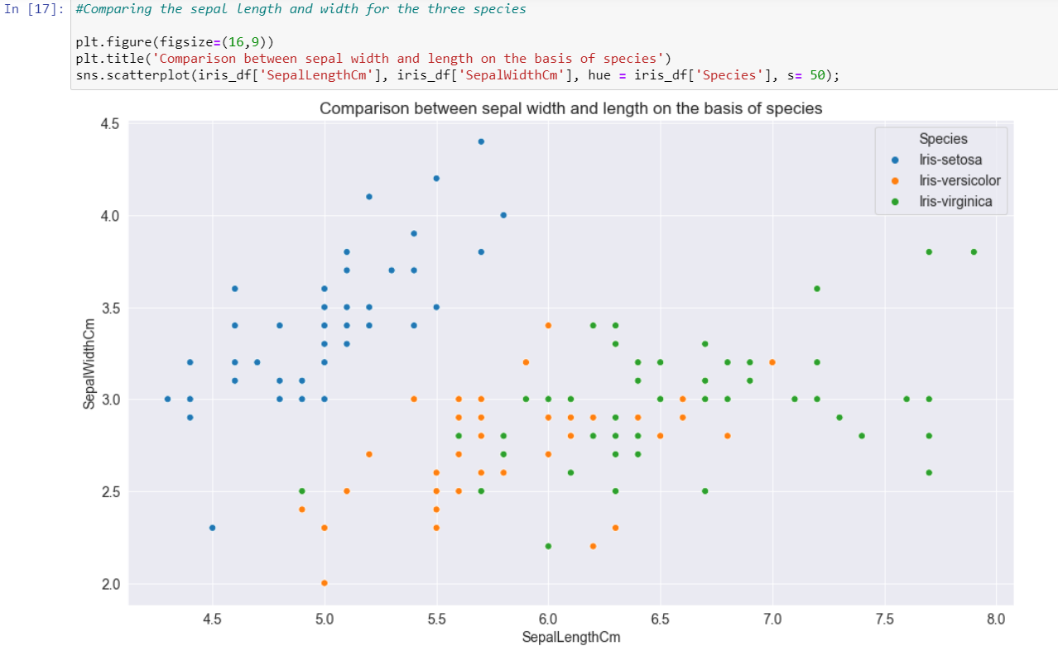
From the above graph, we can tell that the Setosa species has smaller sepal length but higher width. While we see Versicolor lies in almost middle for length as well as width. While Virginica has larger sepal lengths and smaller sepal widths.

Slide 6
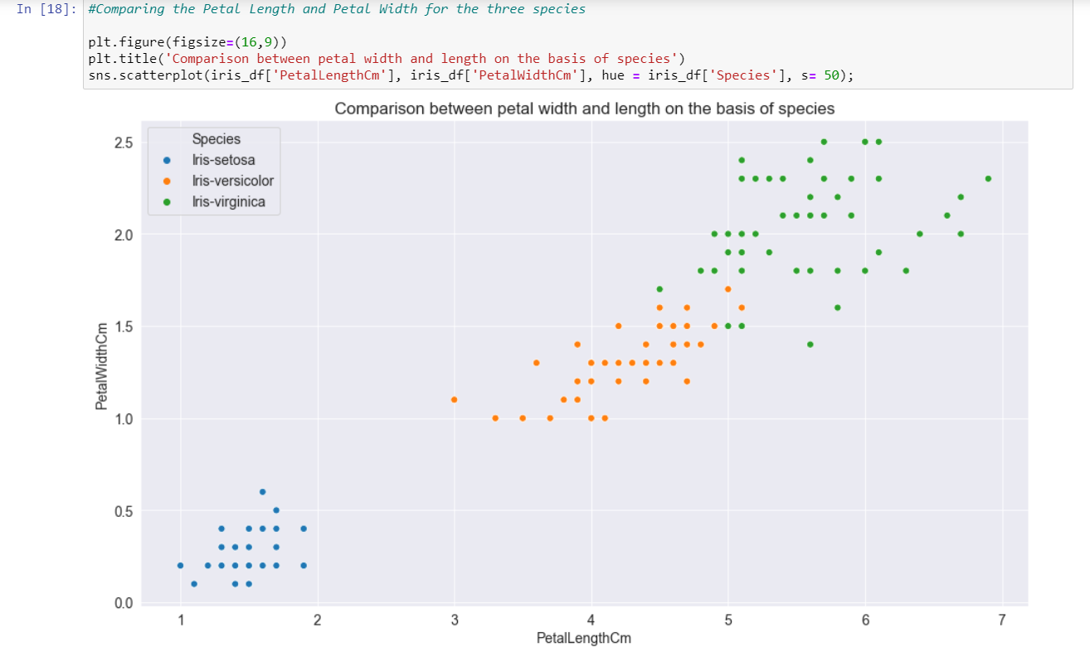
From the above visualization, we can tell that the Setosa species has smaller petal length and width. While we see Versicolor lies in almost middle for length as well as width. While Virginica has larger petal lengths and widths.

Slide 7
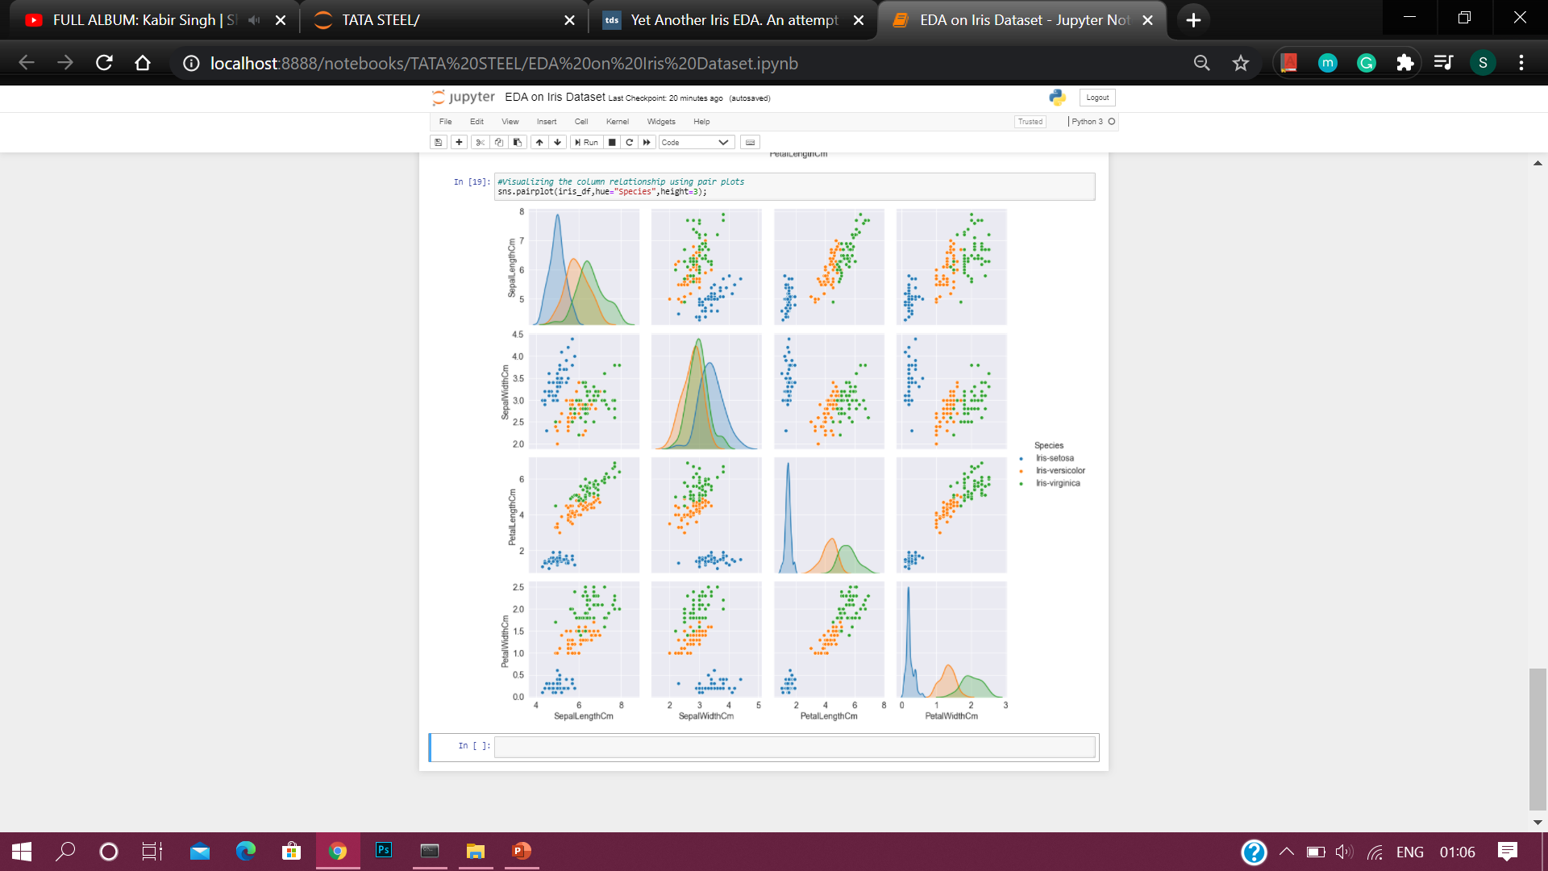
VISUALIZATION OF COLUMN RELATIONSHIP USING PAIR PLOTS

Slide 8
Pair plot represents the relationship between our target and the variables.
From the pair plots given in the previous slide, we can observe that –
The Setosa species has a large difference in its characteristics when compared to the other species, it has smaller petal width and length while its sepal width is high and its sepal length is low.
The Versicolor species usually have average dimensions whether it is sepal or petal.
The Virginica has high petal width and length while it has small sepal width but large sepal length.

Slide 9
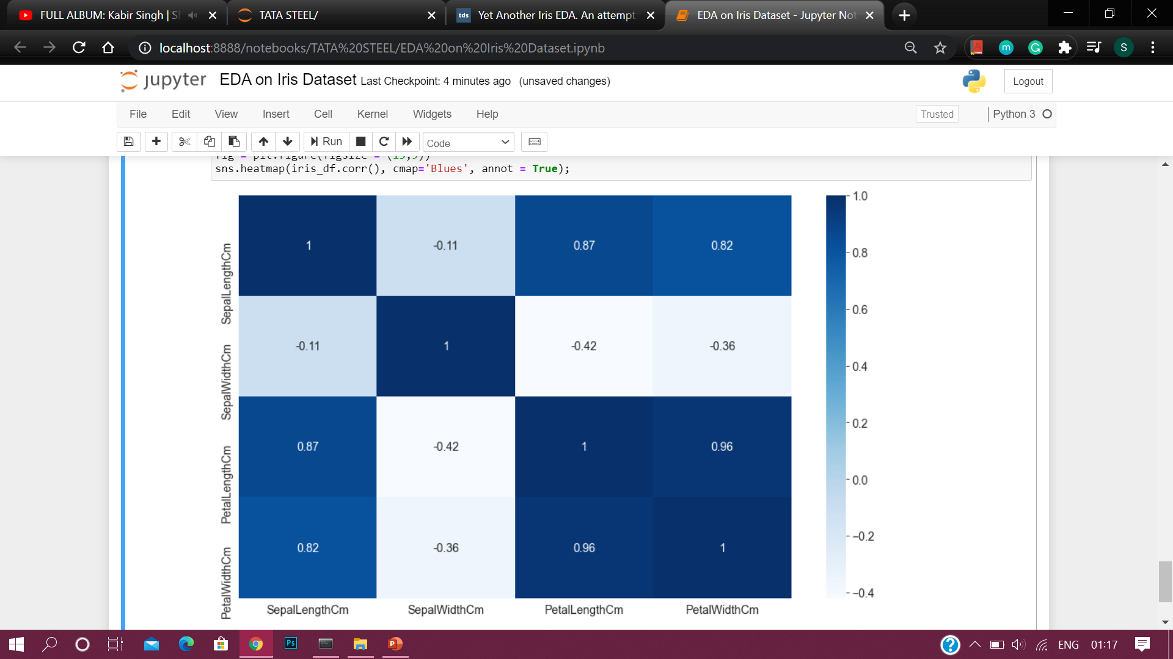
VISUALIZATION OF CORRELATION USING HEATMAP
From the above heatmap, we see that petal length and petal width have a high correlation, petal width and sepal length have good correlation as well as petal length and sepal length have good correlations.

Slide 10
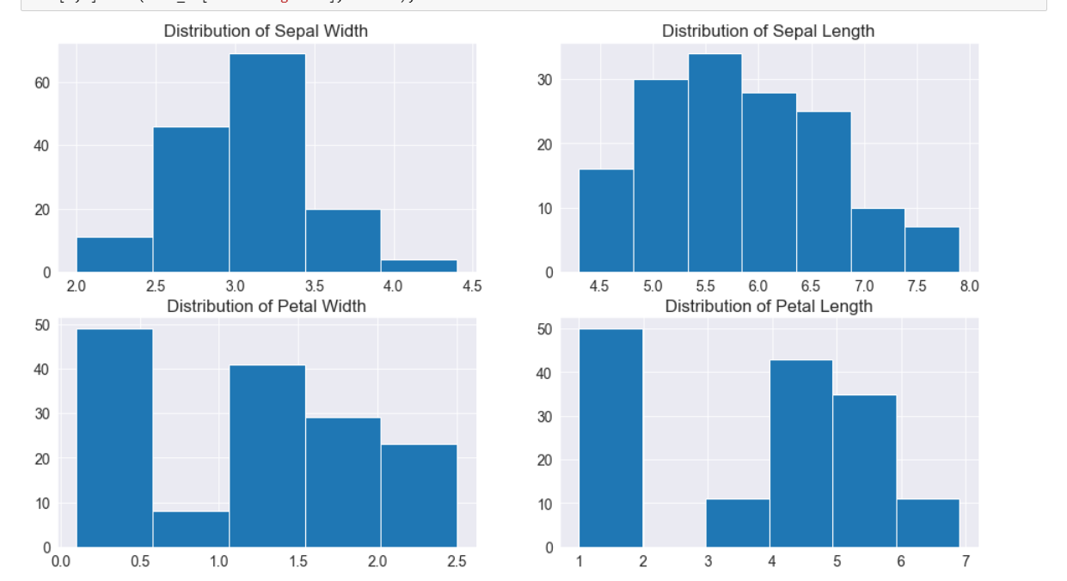
OBSERVATION ON DISTRIBUTION OF DATA USING HISTOGRAM

Slide 11
From the histogram of the four columns, we can observe that –
The Highest frequency of sepal width is between 3.0 to 3.5 which is around 70.
The Highest frequency of sepal length is between 5.5 and 6.0 which is around 35.
The Highest frequency of petal width is between 0 to 0.5 which is around 50.
The Highest frequency of petal length is between 0 to 0.5 which is around 50.

Slide 12
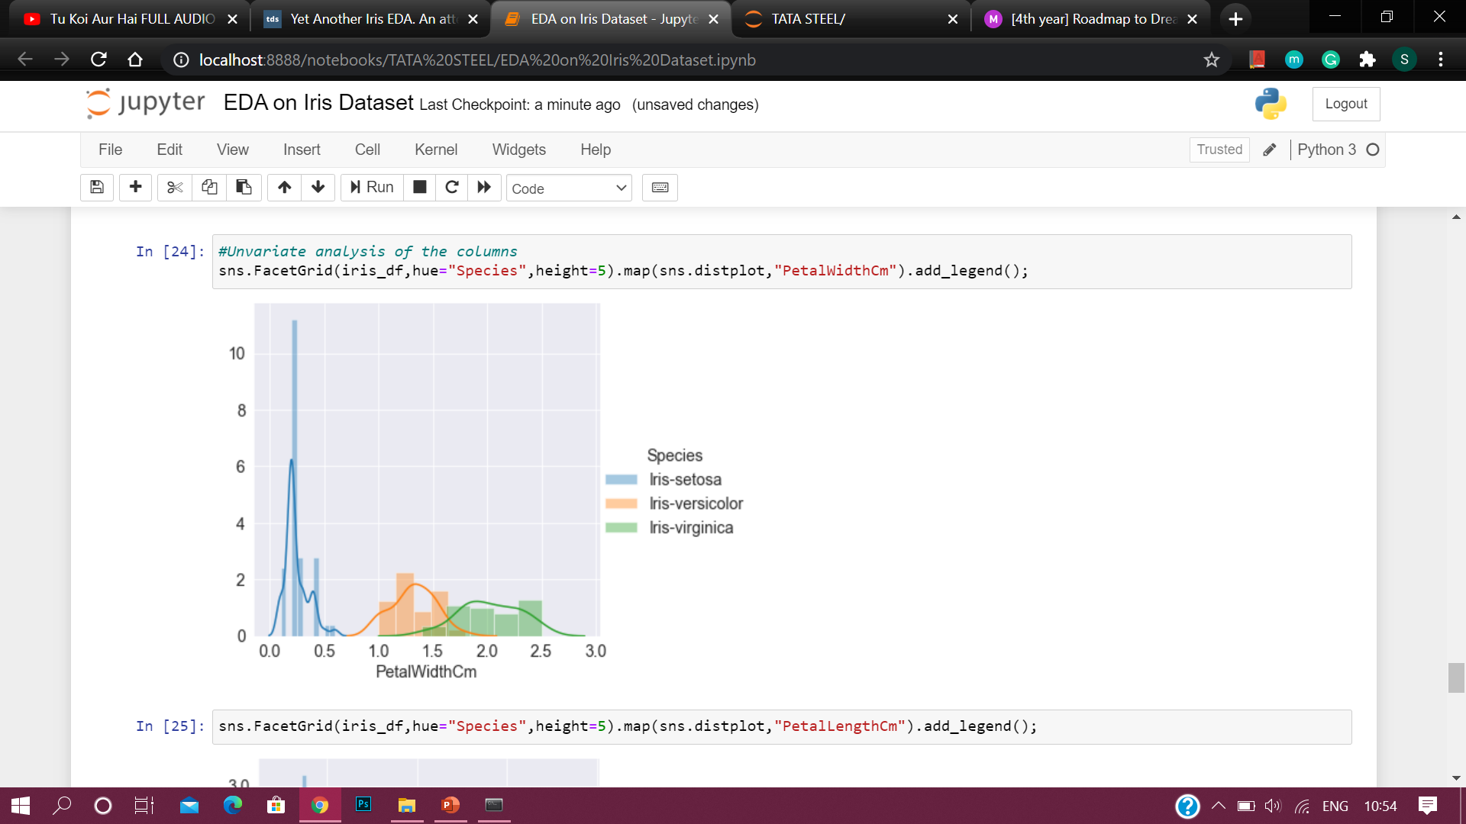
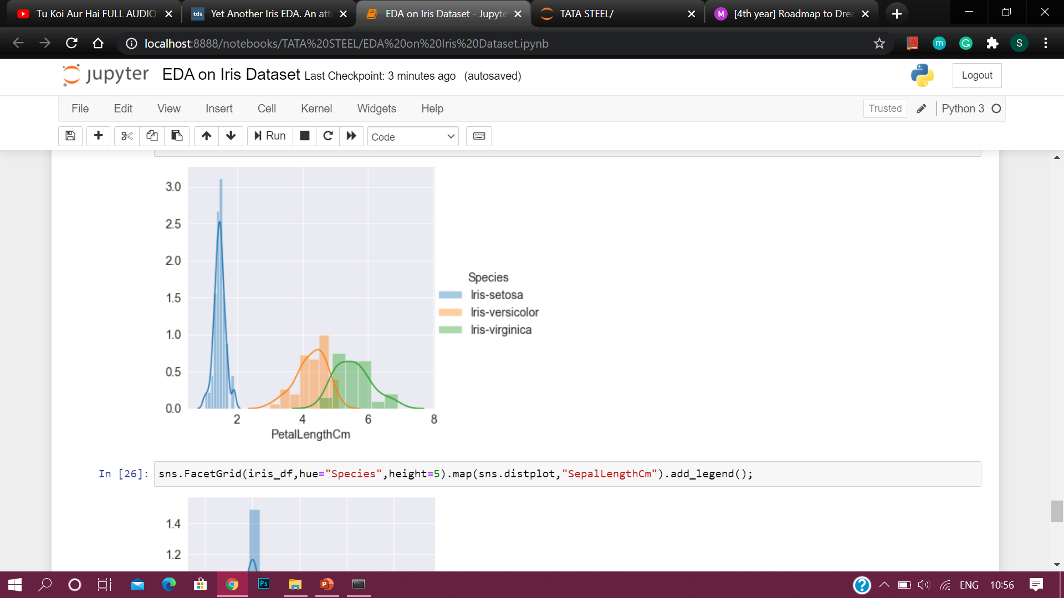
UNVARIATE ANALYSIS OF THE COLUMNS -

Slide 13
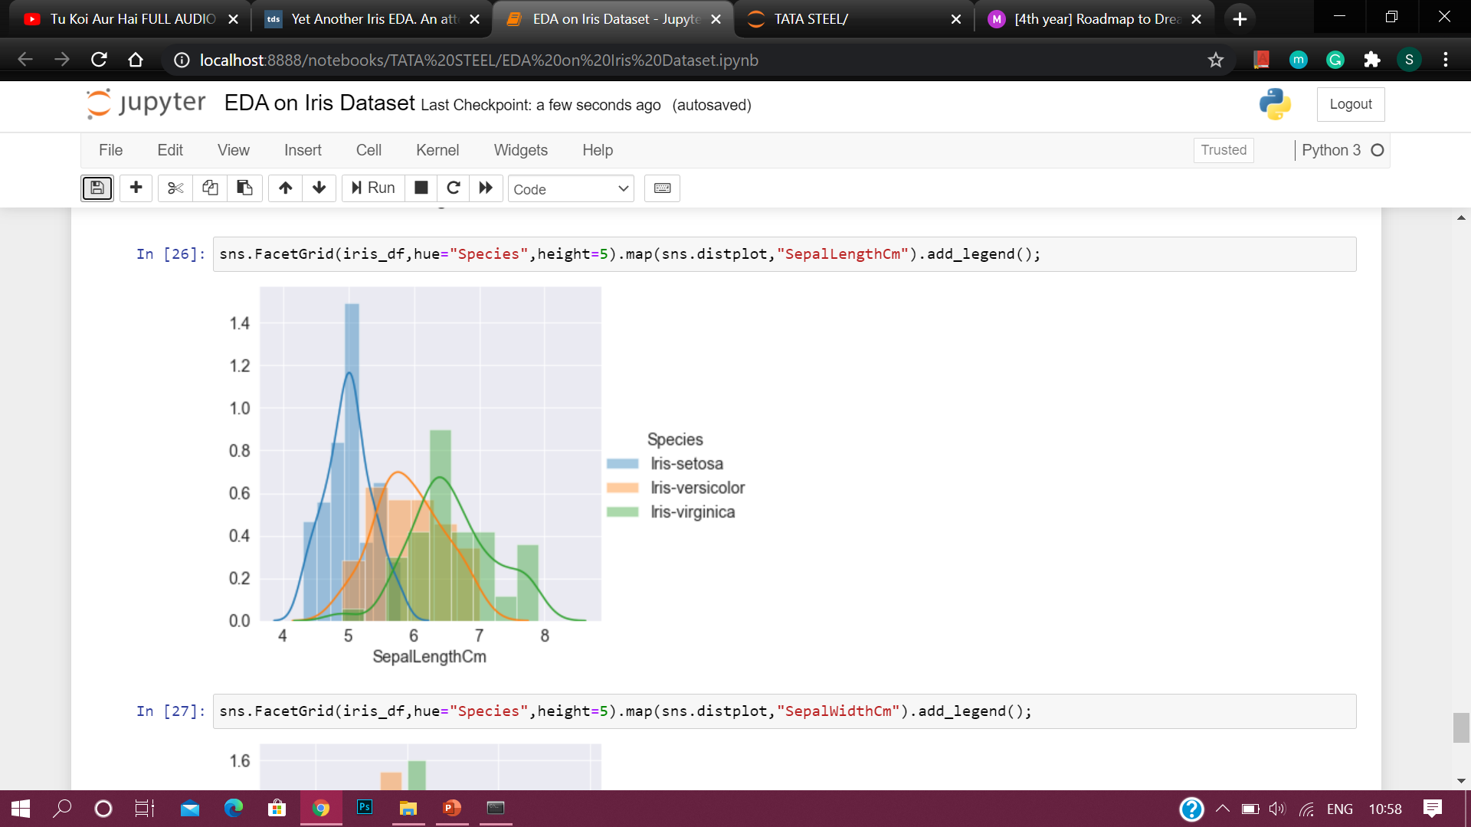
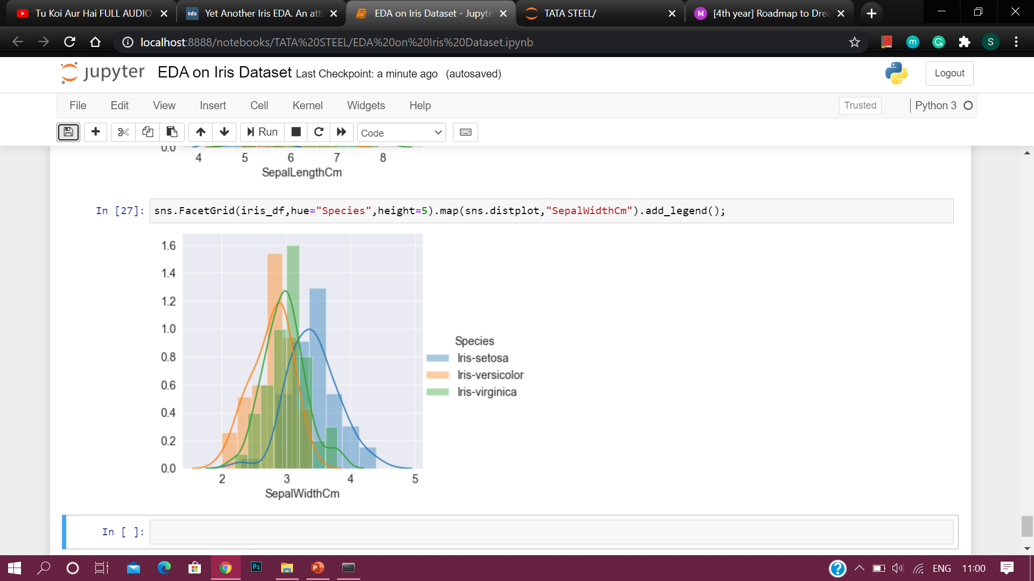
From the above analysis, we observe -
On the basis of petal length or petal width alone, setosa is easily separable while versicolor and virginica are overlapping.
It is quite tough to separate the Species on the basis of sepal length or sepal width alone.
The overlapping of species is the most in case of Sepal Width

Slide 14
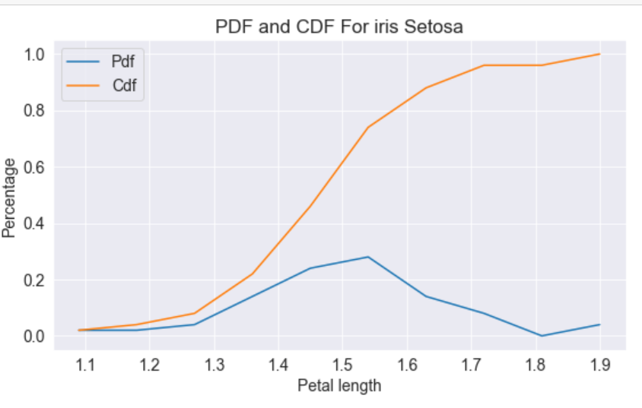
PROBABILITY DENSITY FUNCTION & CUMULATIVE DENSITY FUMCTION FOR VARIOUS SPECIES -
We compute the probability density function & the cumulative density function of the three species on the basis of the Petal Length as, we saw from the previous graph that the species are most separable by the petal length.

Slide 15
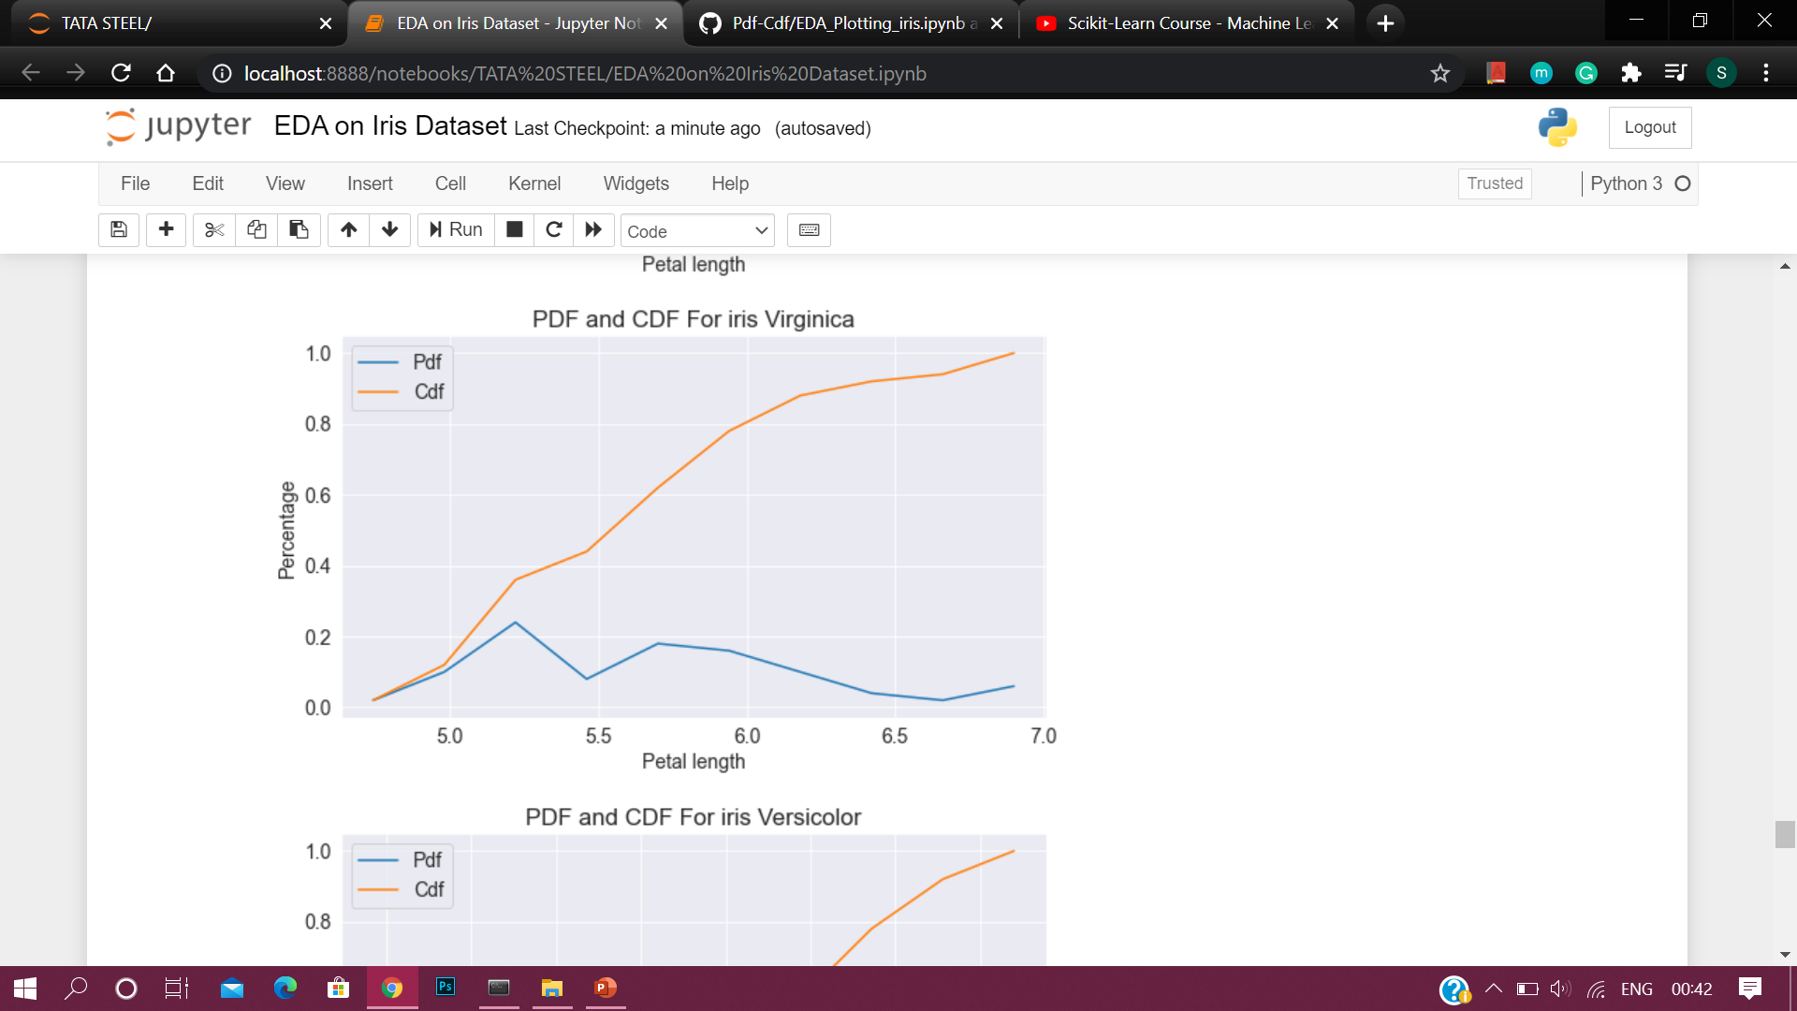
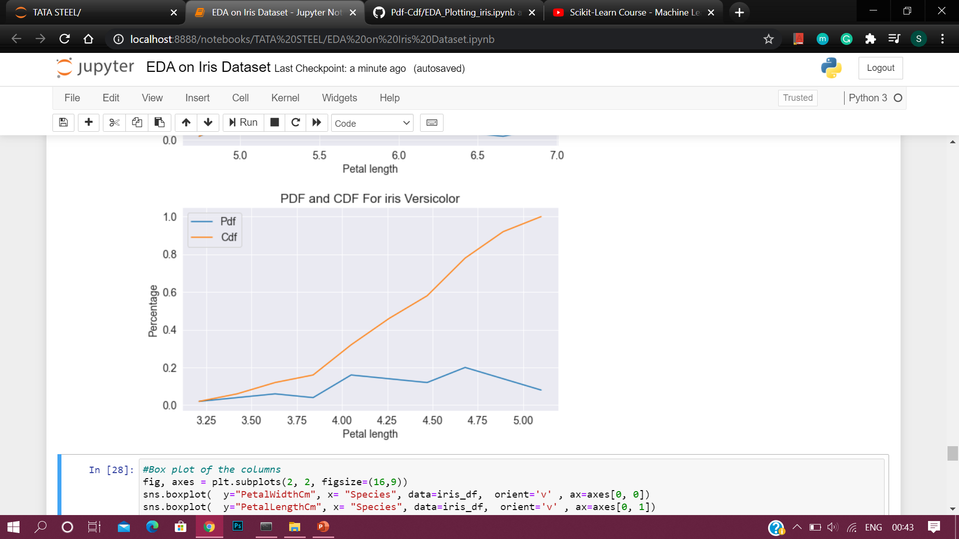

Slide 16
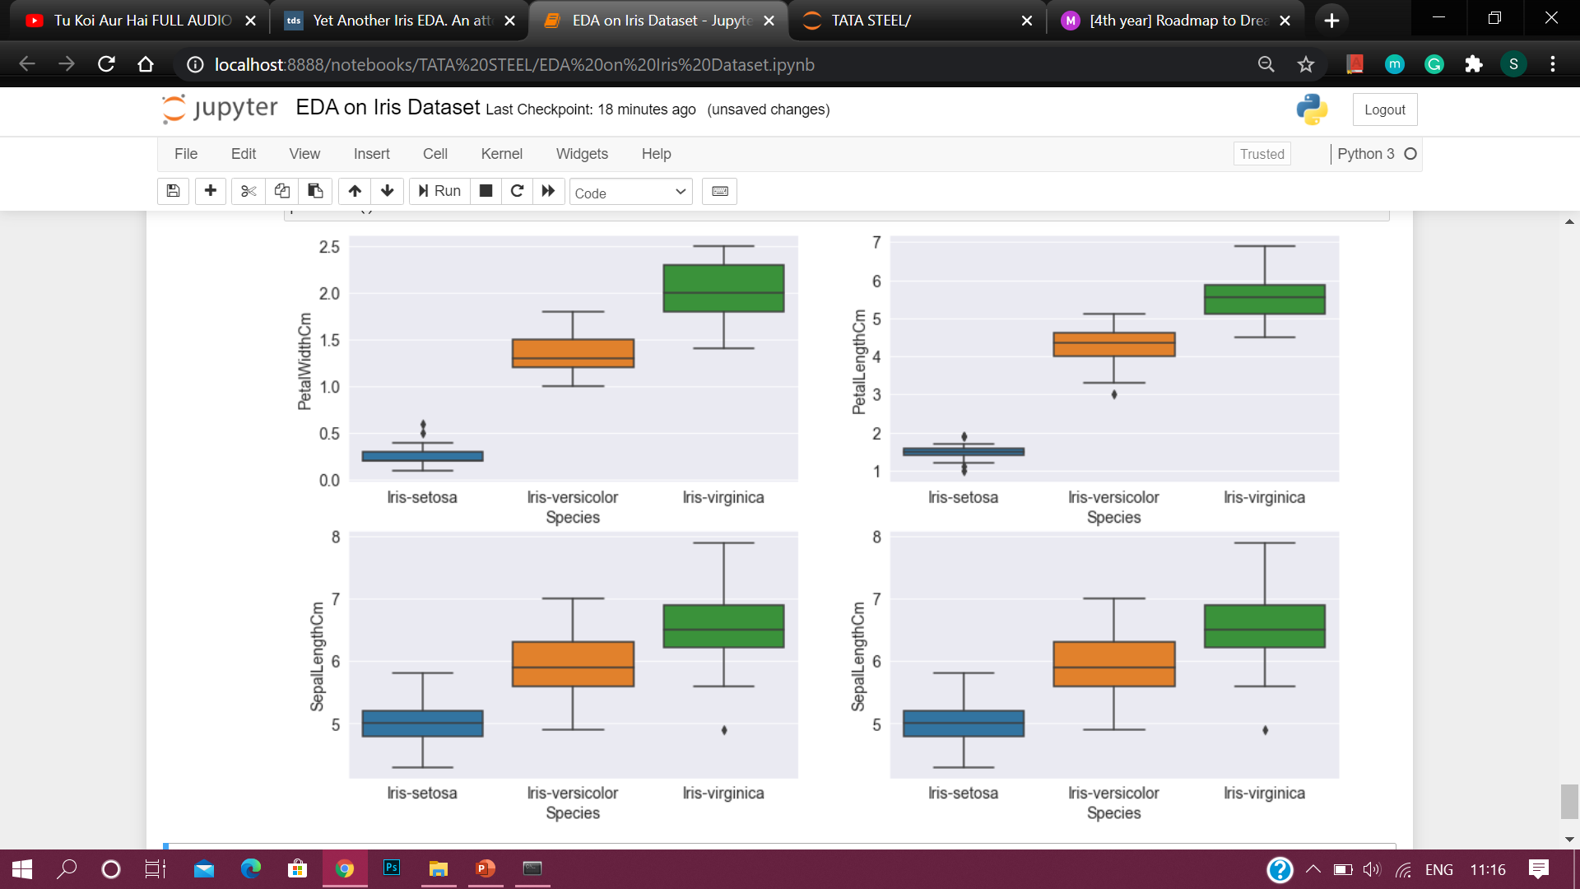
Further, we see that the box plots describe that the setosa usually has smaller features with few outliers.
The Versicolor species has average features.
The Virginica species has the longest features widths and lengths as compared to others.

Slide 17
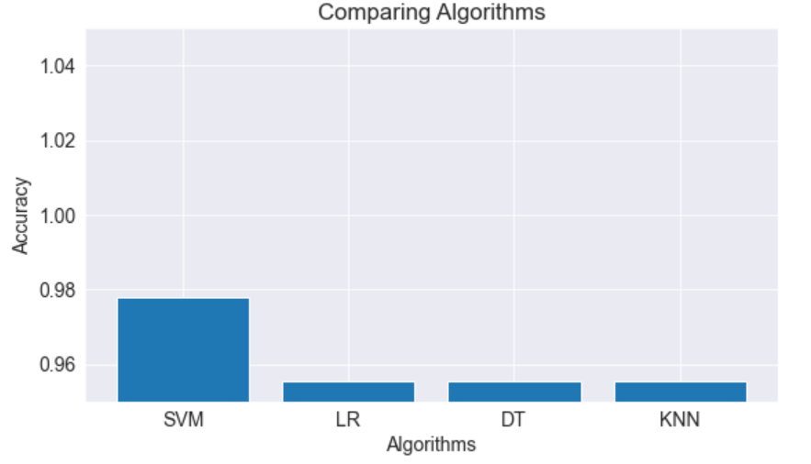
USING SCIKIT LEARN AND PREDICTING ACCURACY OF VARIOUS ML MODELS -
We compute the accuracy of the dataset by dividing 70% of the dataset as training data and 30% of the dataset as testing data.
The graph shows clearly that Support Vector Machine (SVM) gives the maximum accuracy.

Slide 18
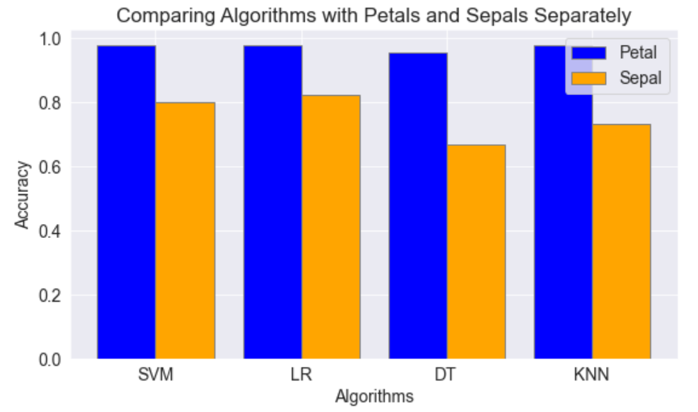
PREDICTING ACCURACY BY USING PETAL AND SEPAL DATASET SEPARATELY -
Using Petals over Sepal for training the data gives a much better accuracy.
This was expected as we saw in the heatmap above that the correlation between the Sepal Width and Length was very low whereas the correlation between Petal Width and Length was very high.

Slide 19
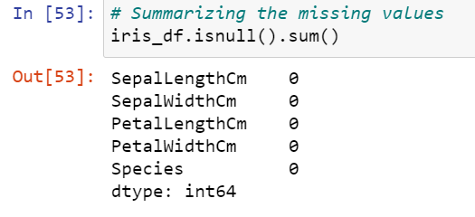
FEATURE ENGINEERING -
To improve the predictions of our ML model, we apply various feature engineering techniques.
First of all we check for any missing values, but since there are no missing values, we cannot apply imputation.
Hence we go for checking for outliers.

Slide 20
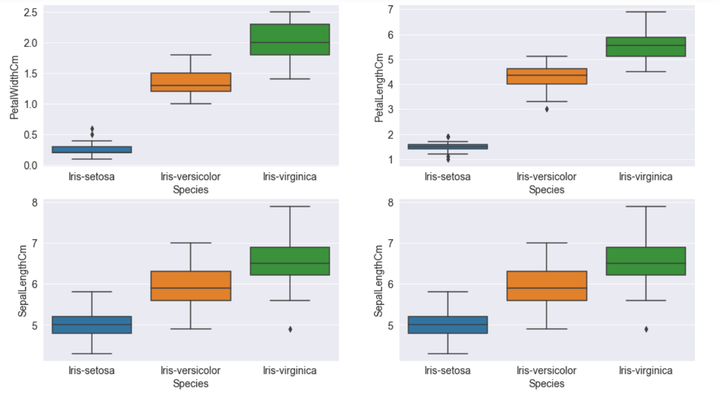
CHECKING FOR OUTLIERS USING BOX PLOT -
As we can see, there are many points plotted outside the box plot (outliers) for
Iris-setosa in Petal Width and Petal Length
Iris-versicolor in Petal Length
Iris-virginica in Sepal Length and Sepal Width

Slide 21
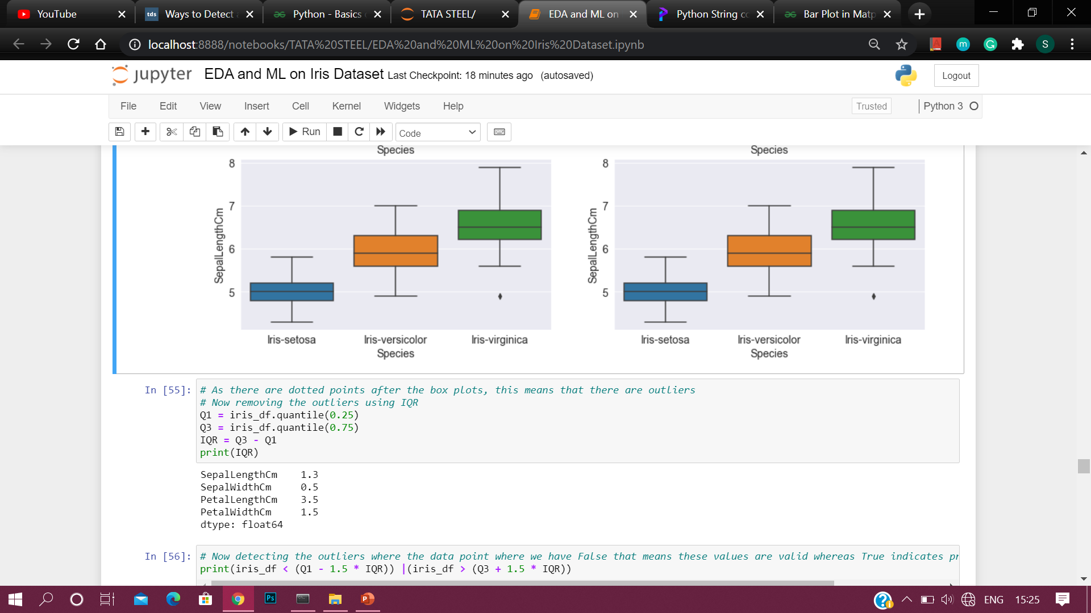
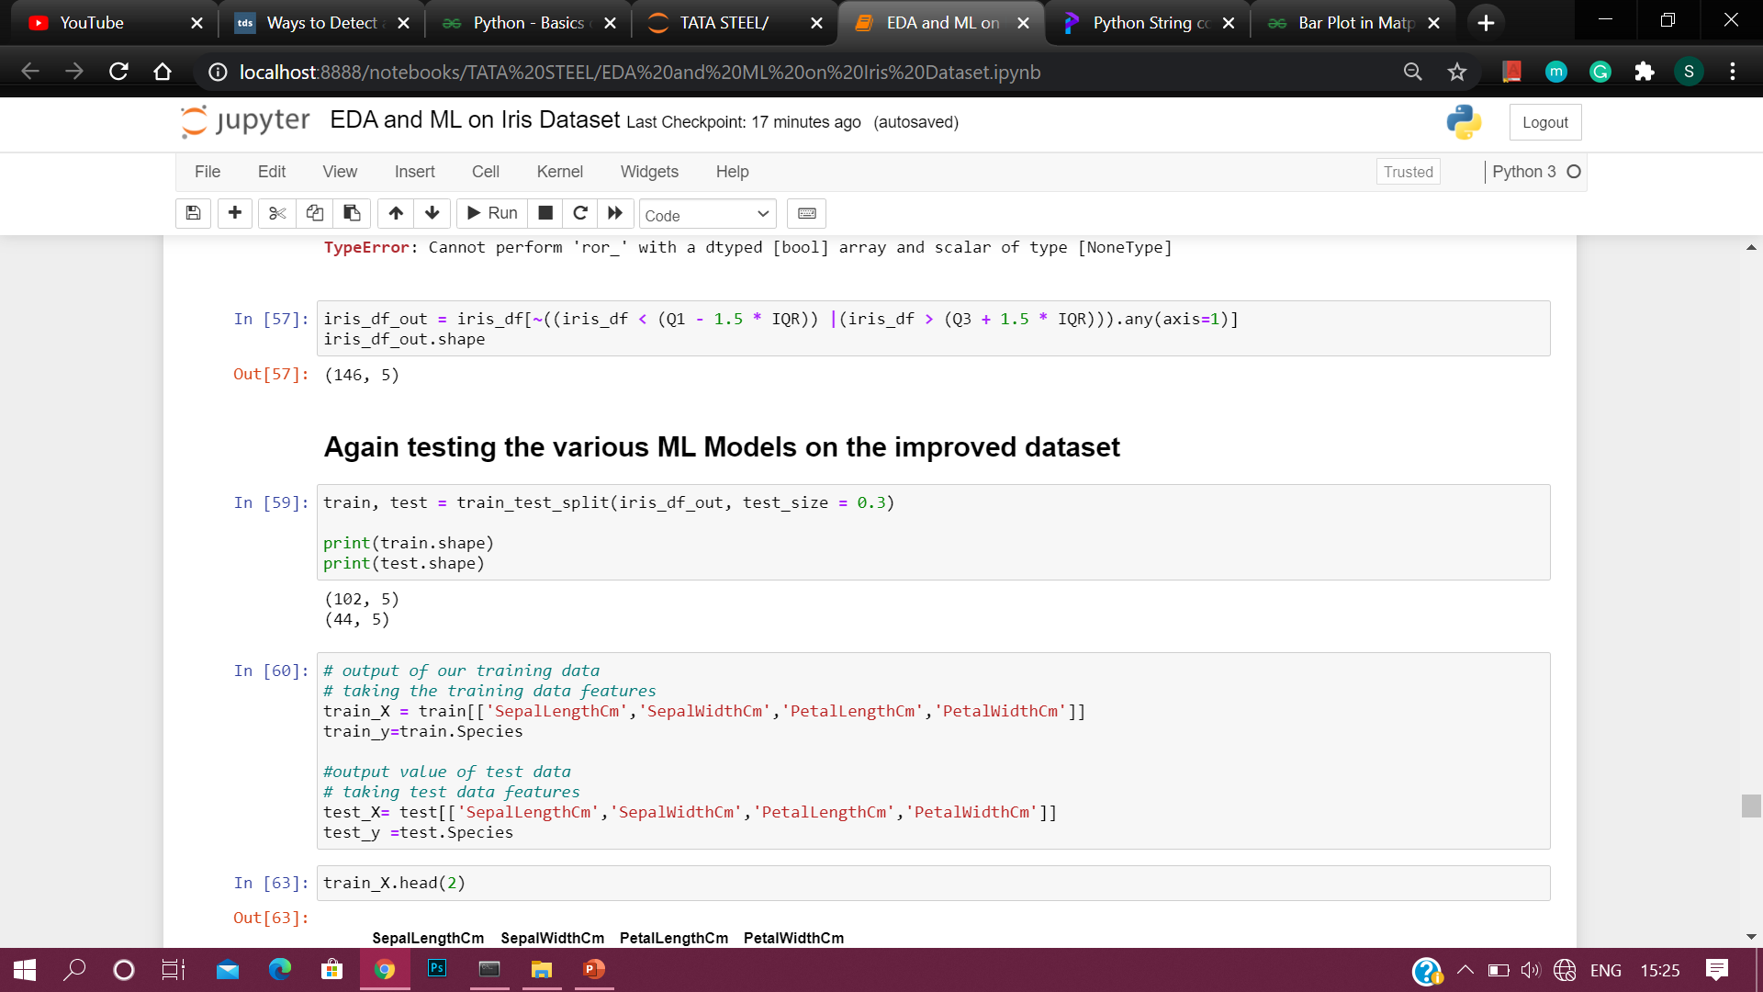
Now we use IQR (Inter Quartile Range) to remove the outlier values present in the dataset.
4 values were removed and so the new dataset has 146 values.

Slide 22
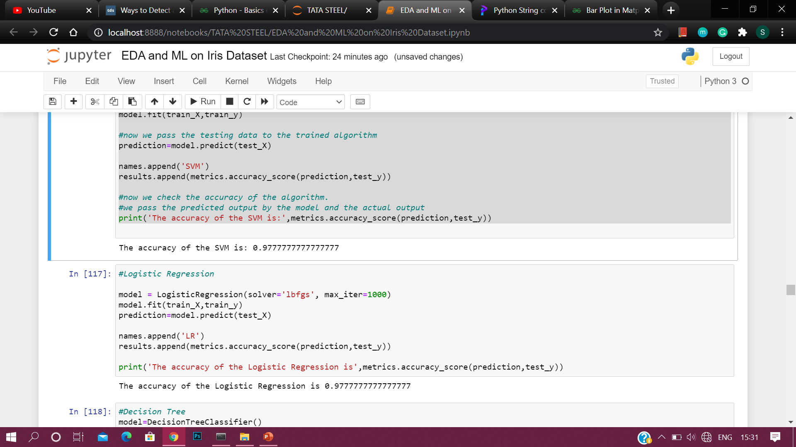
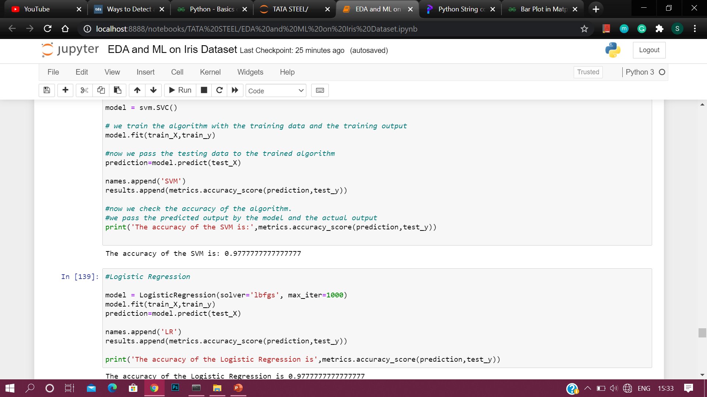
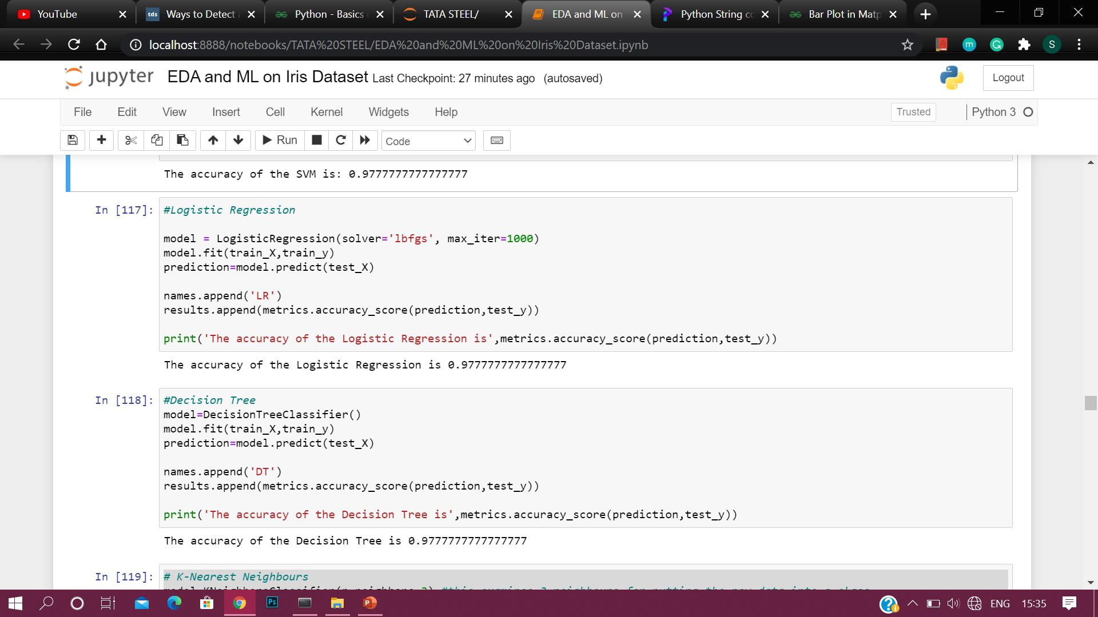
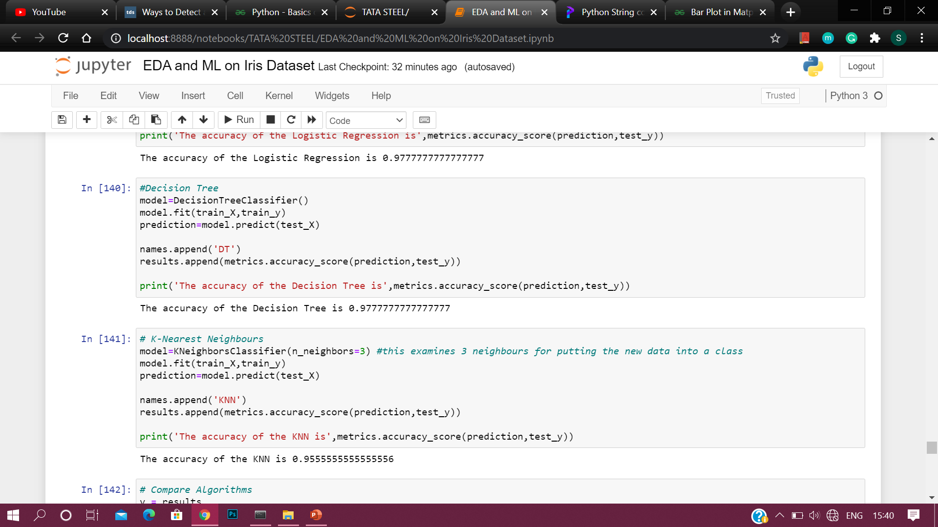
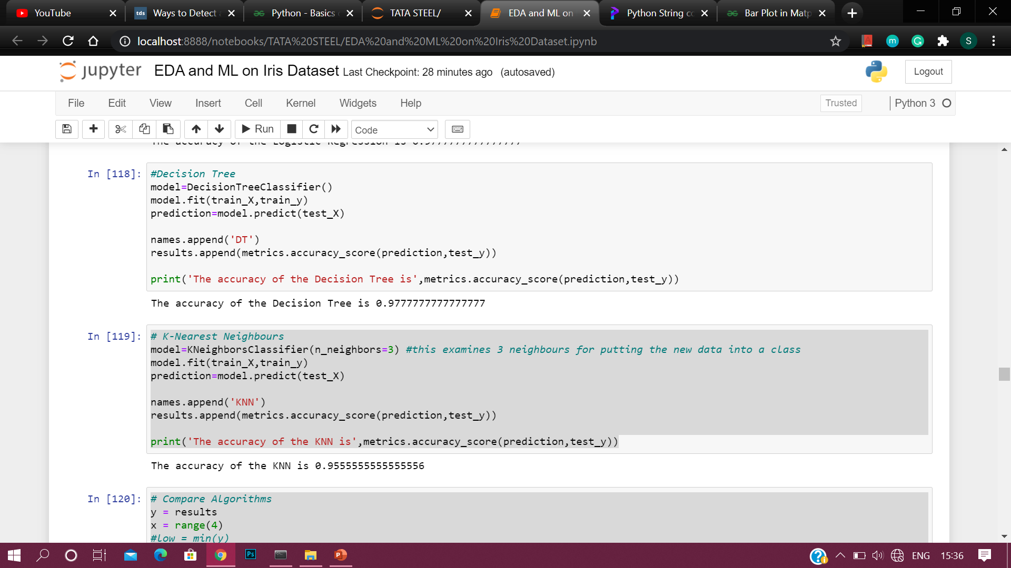
COMPARING THE ACCURACY OF OLD DATASET WITH THE NEW ONE FOR VARIOUS ML MODELS -
Before removing outliers
After removing outliers
Support Vector Machine (SVM)
Logistic Regression
Decision Tree
K Nearest Neighbours (KNN)
Support Vector Machine (SVM)
Logistic Regression
Decision Tree
K Nearest Neighbours (KNN)

Slide 23
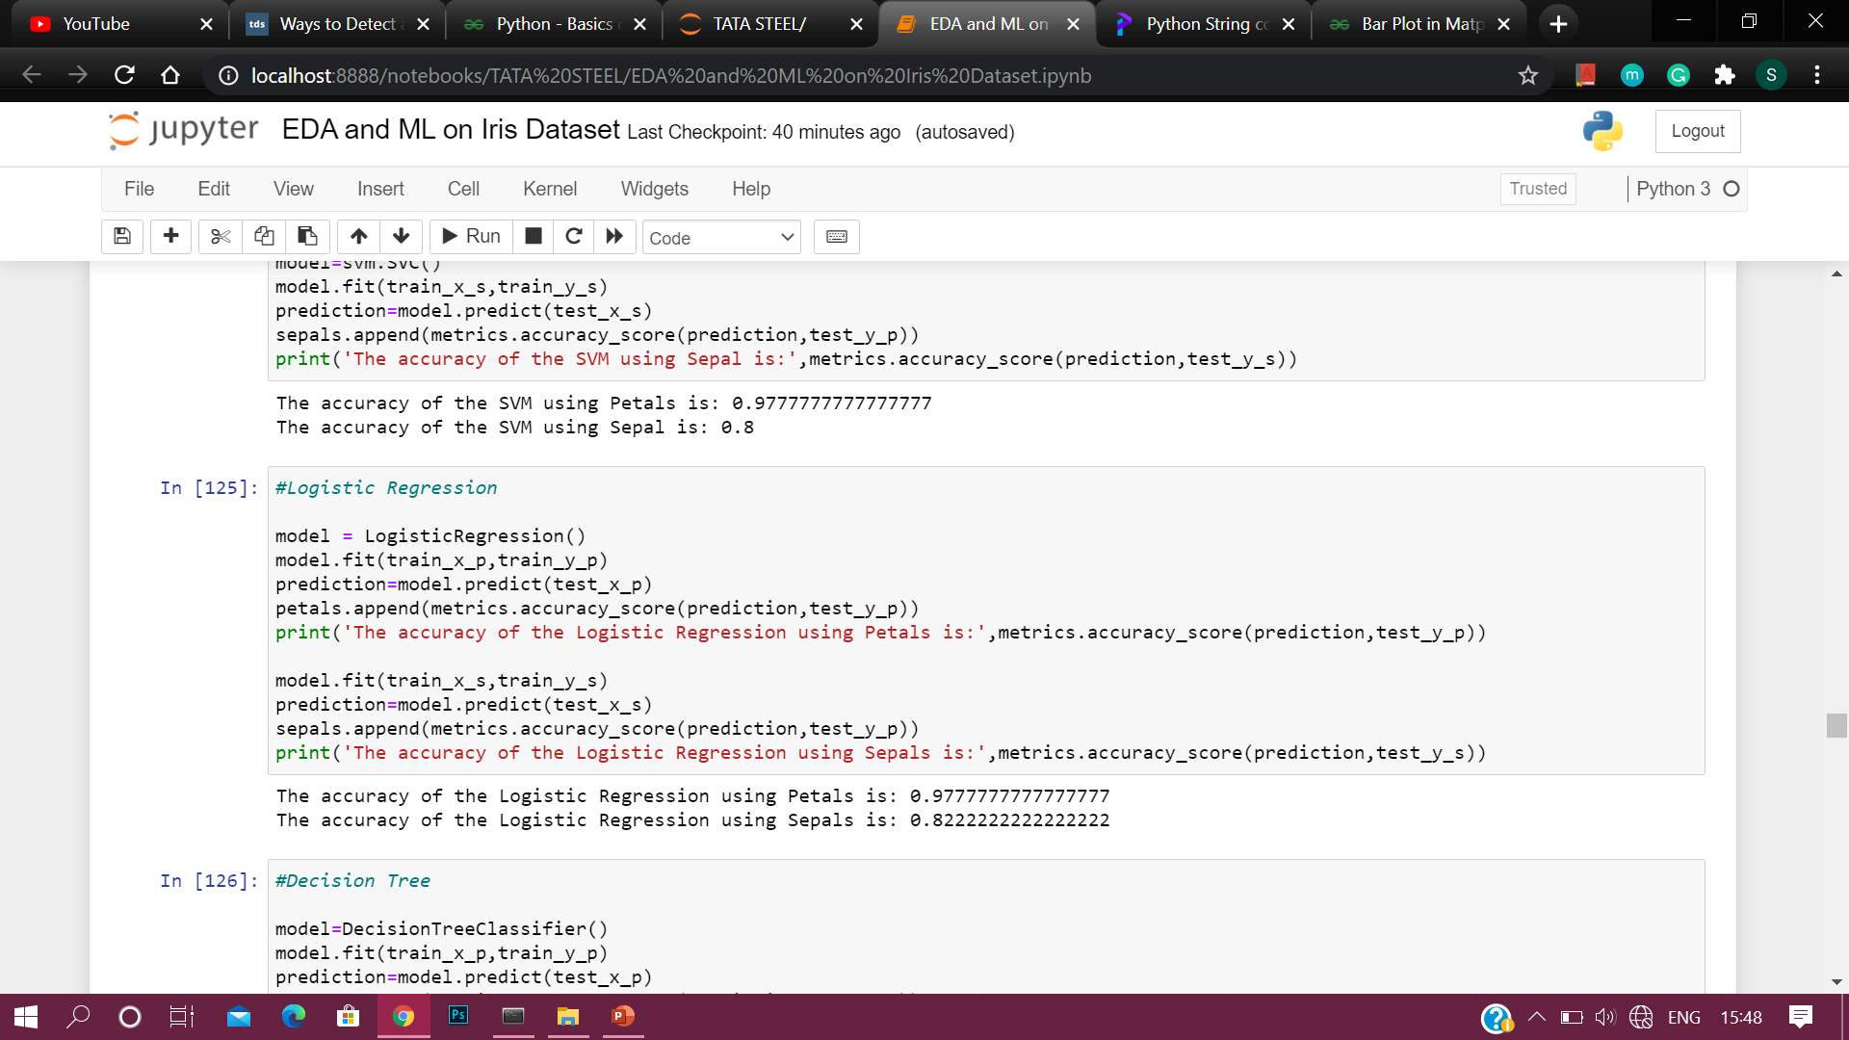
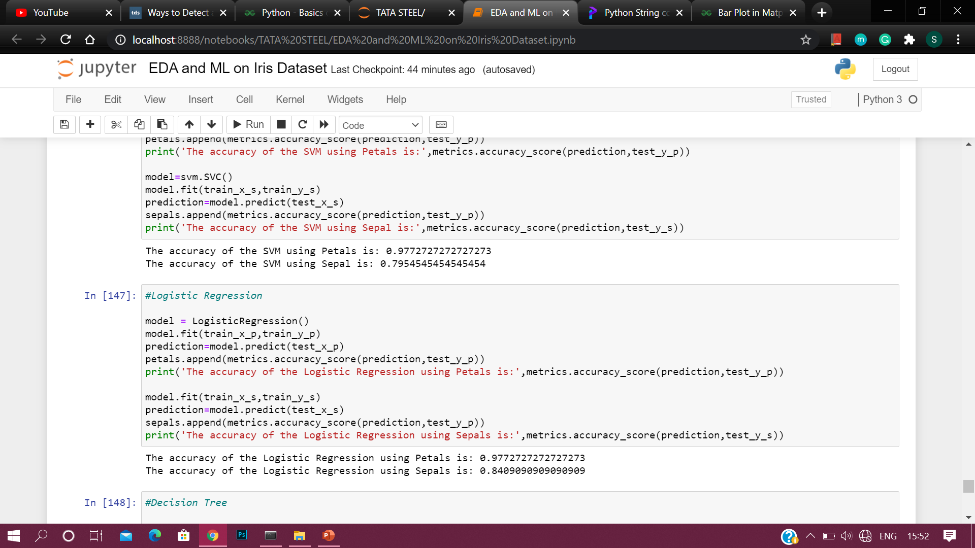
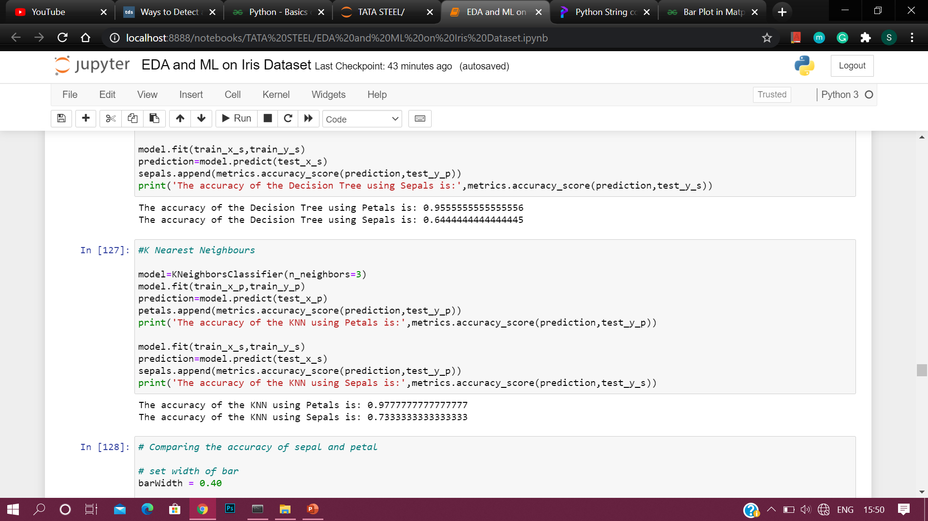
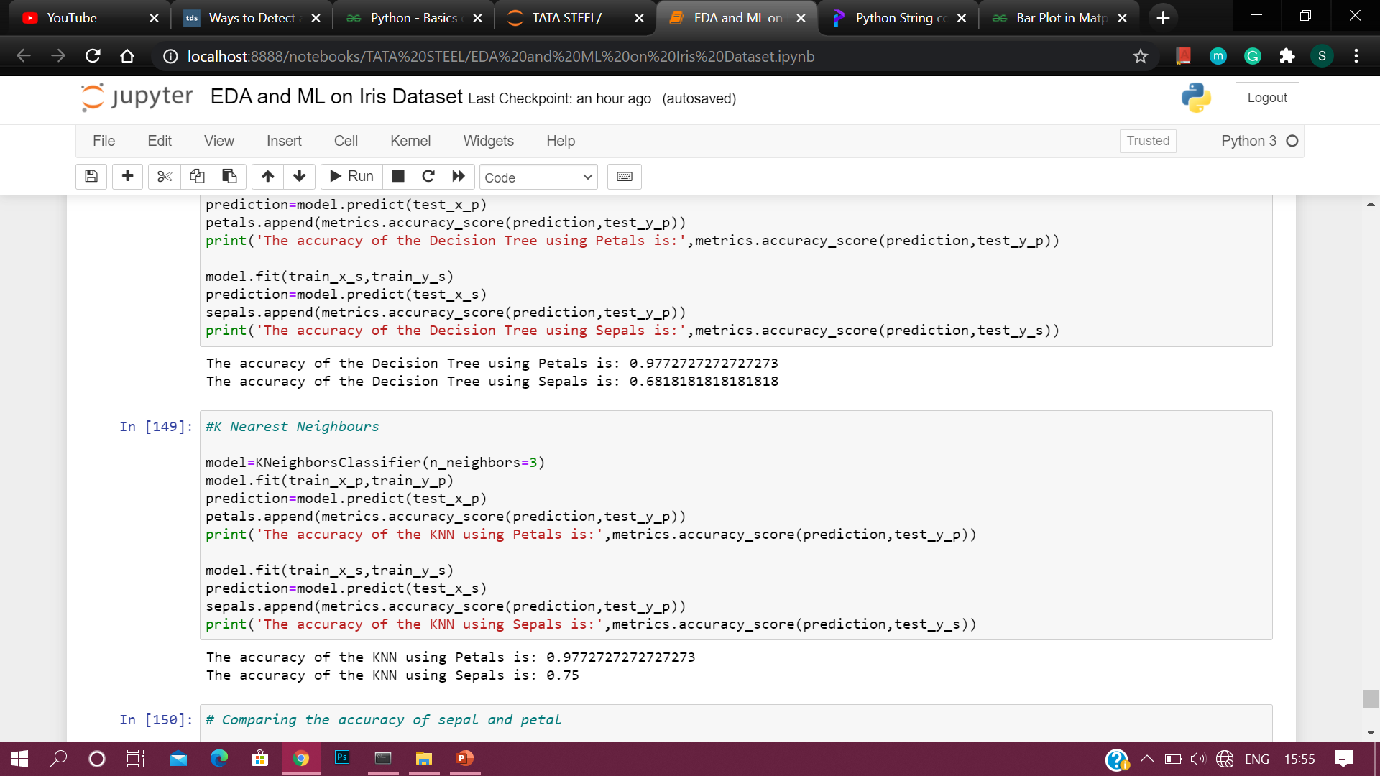
COMPARING THE ACCURACY FOR OLD AND NEW DATASETS FOR PETALS AND SEPALS SEPARATELY-
Before removing outliers
After removing outliers
Support Vector Machine (SVM)
Logistic Regression
Decision Tree
K Nearest Neighbours (KNN)
Support Vector Machine (SVM)
Logistic Regression
Decision Tree
K Nearest Neighbours (KNN)

Slide 24
CONCLUSION -
The dataset is balanced i.e. equal records are present for all three species.
We have four numerical columns while just one categorical column which in turn is our target column.
A strong correlation is present between petal width and petal length.
The Setosa species is the most easily distinguishable because of its small feature size.
The Versicolor and Virginica species are usually mixed and are sometimes hard to separate, while usually Versicolor has average feature sizes and Virginica has larger feature sizes.
The accuracy of the dataset on all the four major ML models is above 92%
Using Petals over Sepal for training the data gives a much better accuracy, as we saw in the heatmap that the correlation between the Sepal Width and Length was very low whereas the correlation between Petal Width and Length was very high.
Since the dataset is balanced and has no missing values, applying feature engineering does not improve the accuracy of the dataset significantly.

Slide 25
THANK YOU

